Slide 1
Enzymatic Processes in Industrial Production & its application
Assignment –Jaysimha Swamy

Slide 2
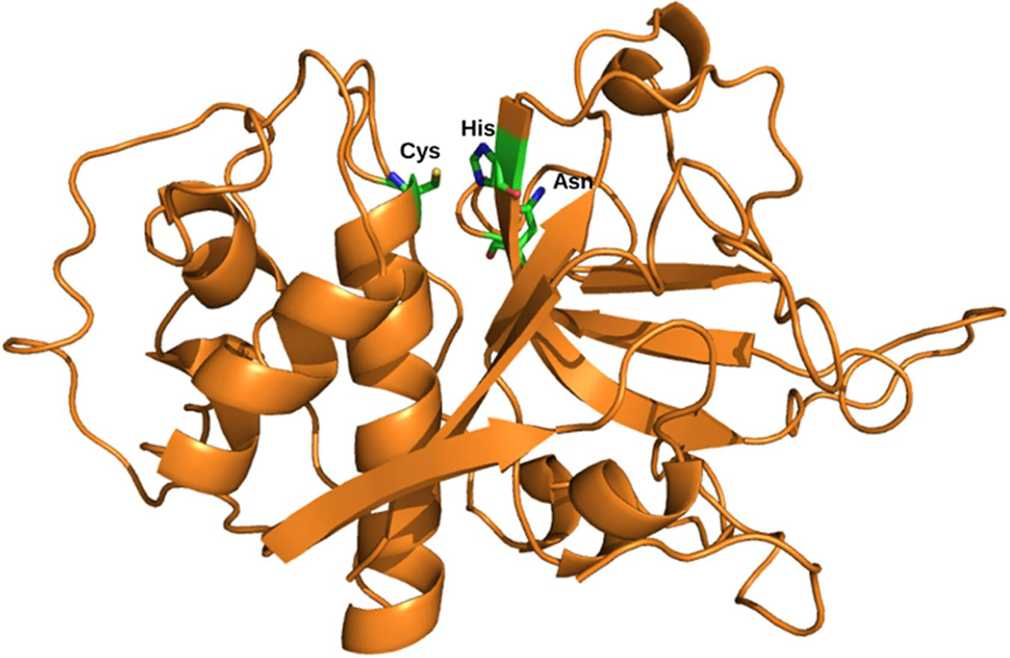
PROTEASE
also called a peptidase, proteinase, or proteolytic enzyme
Protease is a protein digesting enzymes.
They are mostly used in the detergent industry .
Proteases are the largest group of industrial enzymes
More than half of the worlds industrial enzyme produce is Protease.
It is also called a “core enzyme” in the detergent industry
This Photo by Unknown Author is licensed under CC BY

Slide 3
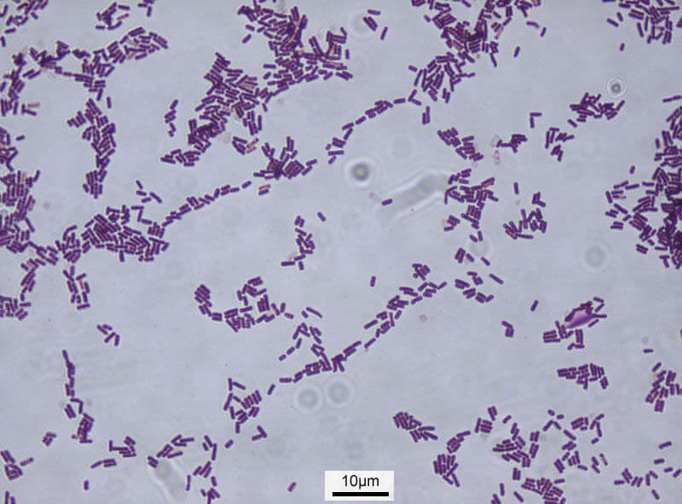
Production of Protease
1.Microorganisms are used like Bacillus subtilis, Bacillus licheniformis or fungi like Aspergillus niger, Aspergillus oryzae are used.
2. These microorganisms are cultured in a nutrient medium at 30–37 °C at a pH of 7-8.5 in an aerobic condition where these microbes natural secrete protease into the medium.
3. This protease is then separated from the medium by filtration and centrifugation later they are concentrated with calcium ions, borates or glycerol. And sometimes encapsulated for further use.
This Photo by Unknown Author is licensed under CC BY-SA-NC

Slide 4
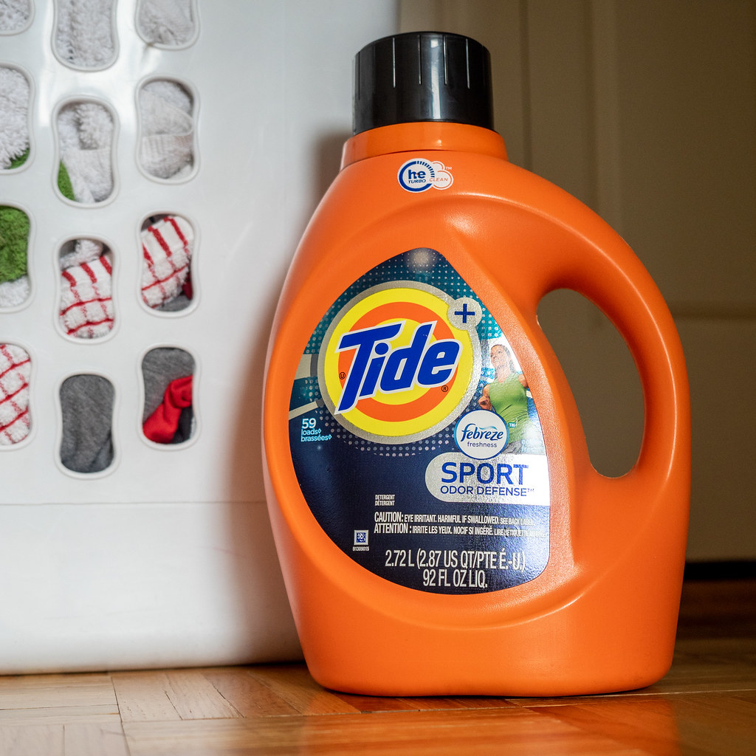
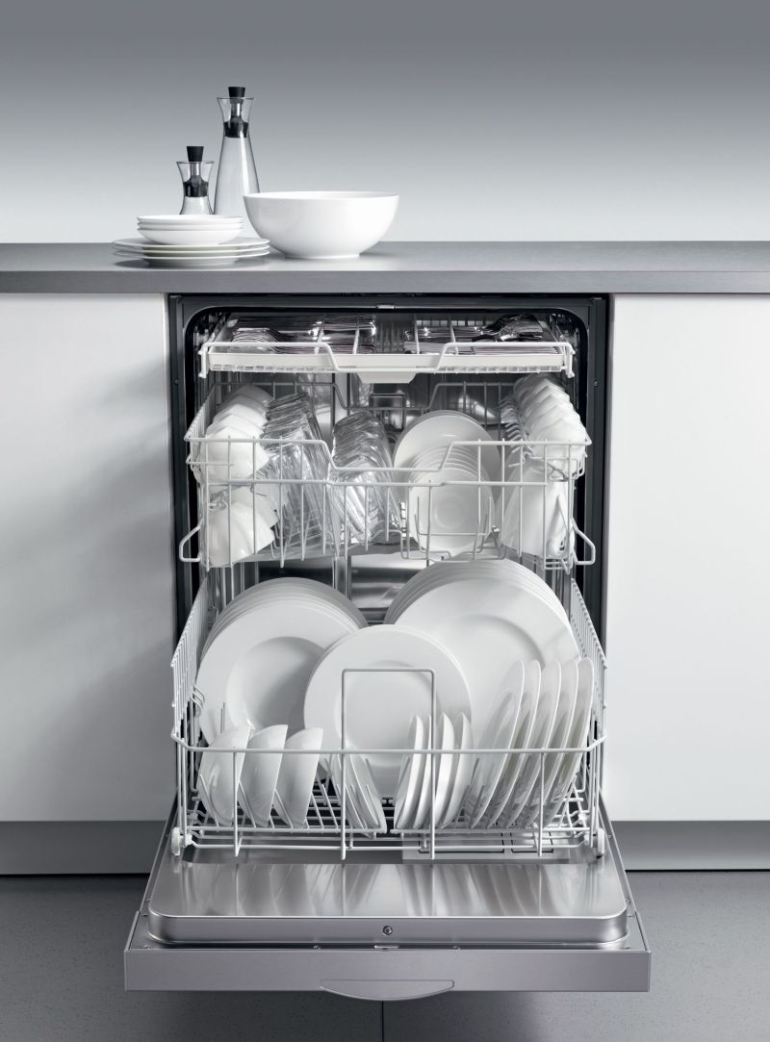
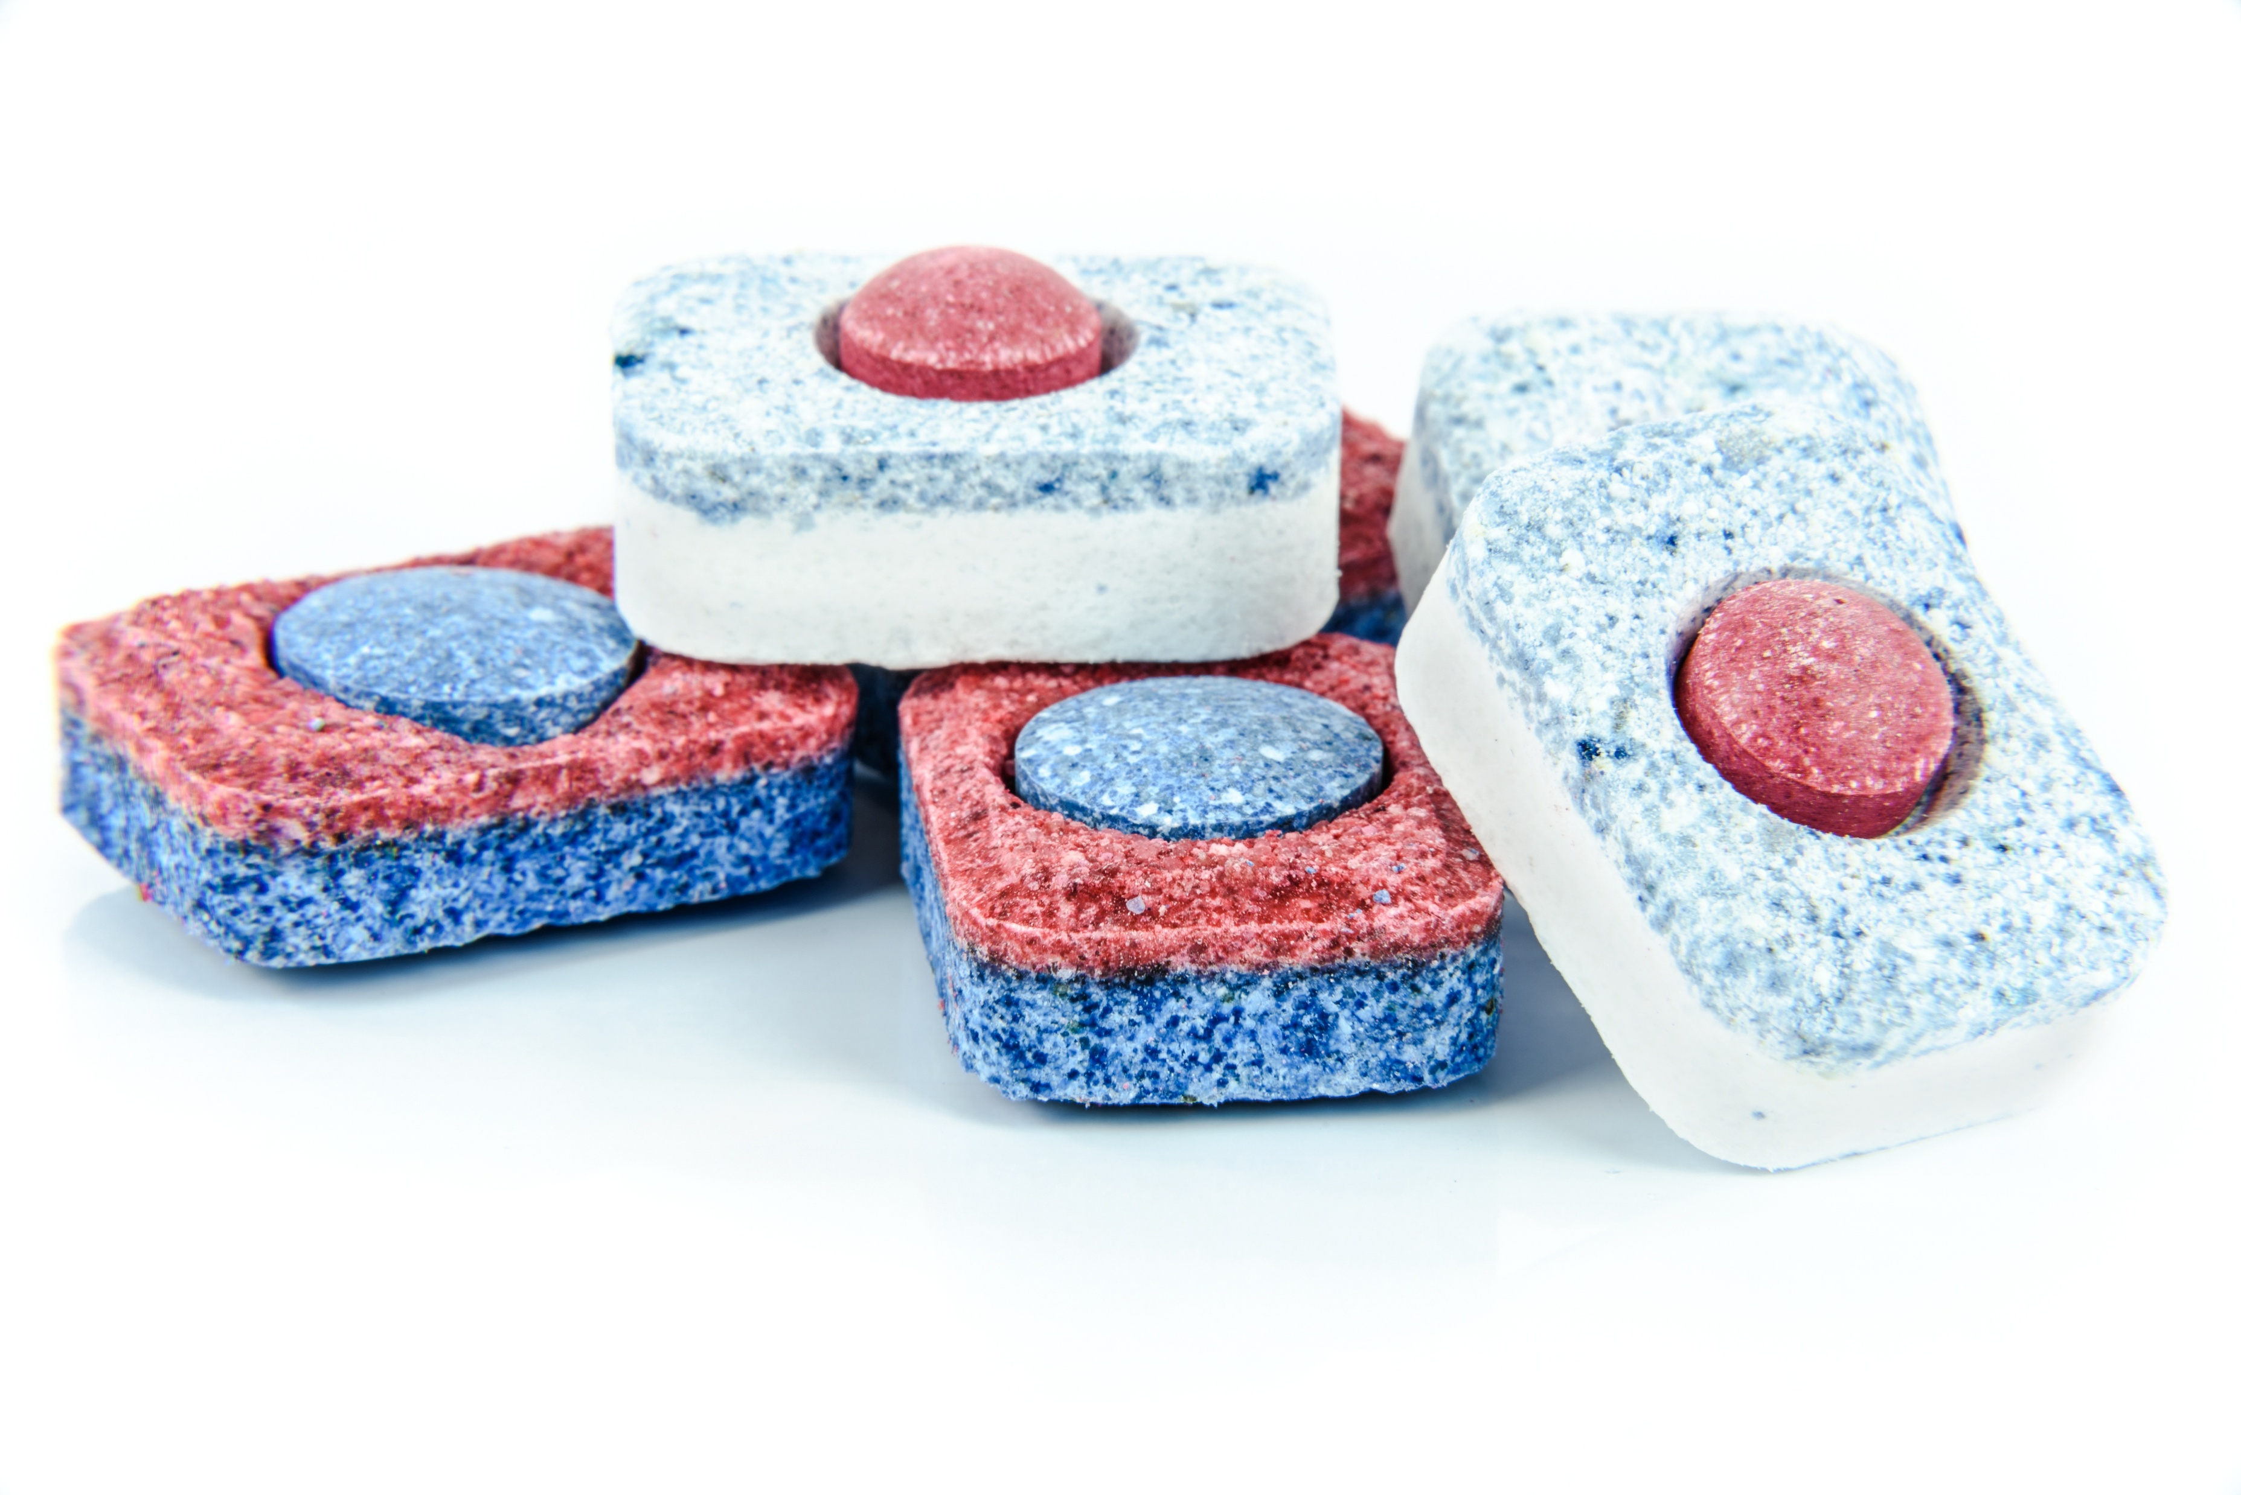
Detergent Industry
Alkaline Proteases are used in laundry detergents, Dishwashing Detergents and specialized detergents in hospitals and labs.
Proteases are used to remove protein based Stains like egg, milk, blood, sweat, etc from garments.
Proteases are added to detergent formulations as granules, encapsulated powders, or liquid suspensions.
Encapsulation prevents enzyme dust (which could cause allergies) and protects the enzyme from other reactive chemicals in the detergent (like bleach).
This Photo by Unknown Author is licensed under CC BY
This Photo by Unknown Author is licensed under CC BY-NC-ND

Slide 5
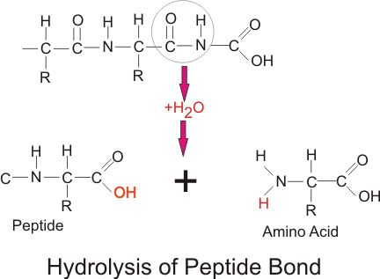
What happens during washing?
Protein stains which stick to the fibres of the fabric.
1.Protease hydrolyses the peptide bonds of these proteins and breaks them down into small peptides and amino acids.
2. These smaller units being water soluble get easily washed away by surfactants and rinsing.
Temperature of the reaction must be between 20-70°C and a pH of 8-10.5(alkaline).
This Photo by Unknown Author is licensed under CC BY-SA

Slide 6
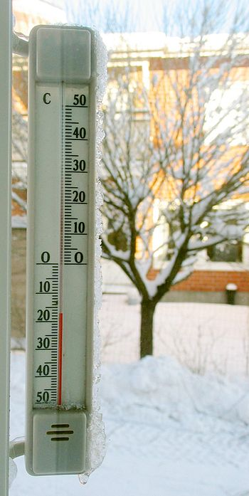

Advantages of using Protease
Removes stubborn protein stains which is not possible with normal detergents.
Allows low temperature effective cleaning hence saving a lot of energy.
Is compatible with a wide variety of surfactants, builders, bleaching agents, and other multi-enzymes detergents with amylase, lipase, cellulase.

Slide 7
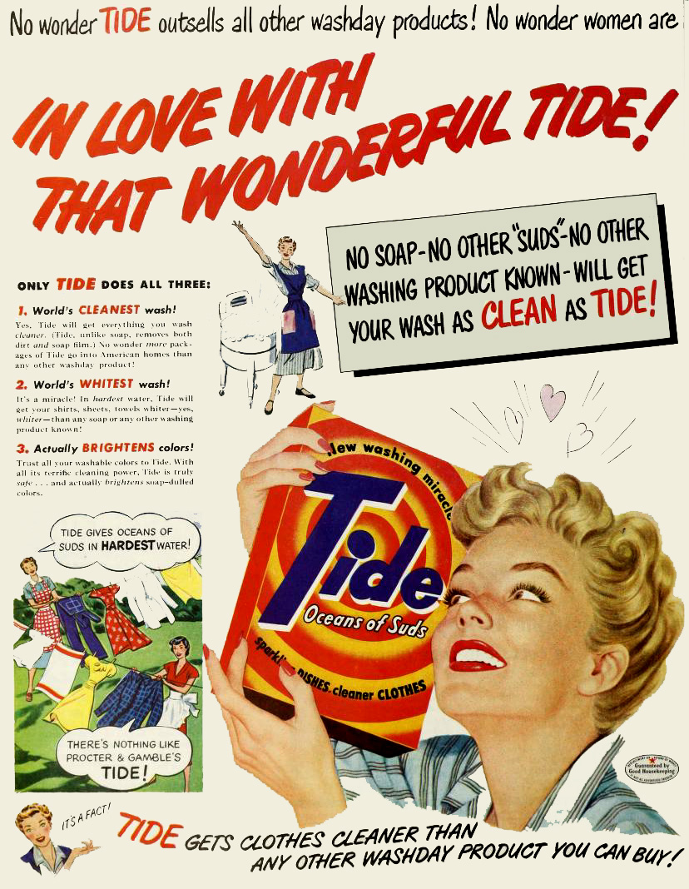

Examples
Laundry detergents-:
1.TIDE—Procter & Gamble
It contains: Protease which is combined with bleach activators brighteners and polymers. It is used for its heavy duty cleaning.
Often protease are kept in granular form to protect them from bleach until they are activated during the wash.
2. ARIEL--Procter & Gamble
It is a bio-enzyme detergent and contains protease to break down protein stains and is paired with amylase to break down starch stains, lipase to break down fat/oil stains and cellulase to brighten fabrics.
It is designed to perform in cold water saving energy
This Photo by Unknown Author is licensed under CC BY-SA-NC

